Slide 1
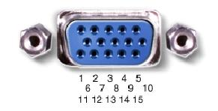
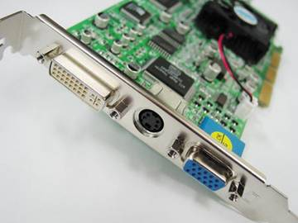
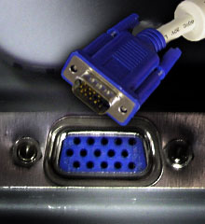
VGA - Display
Example 1: Diagonal line display
Example 2: Cam To VGA
Example 3: Keyboard to VGA
by Nabil CHOUBA

Slide 2
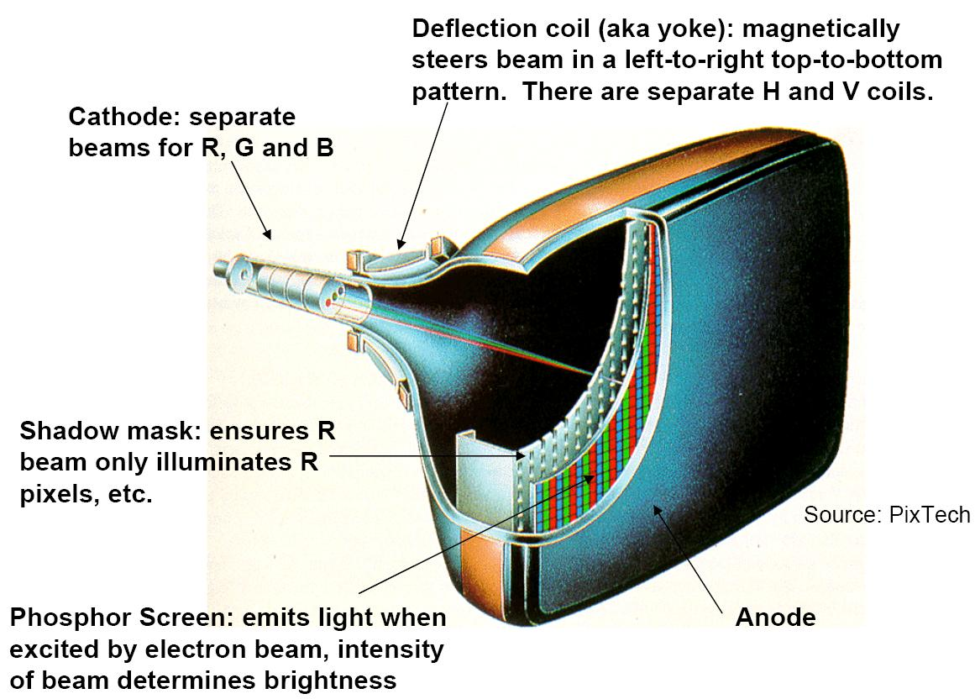
Cathode Ray Tubes

Slide 3
Sync signal
vertical sync
horizontal sync

Slide 4
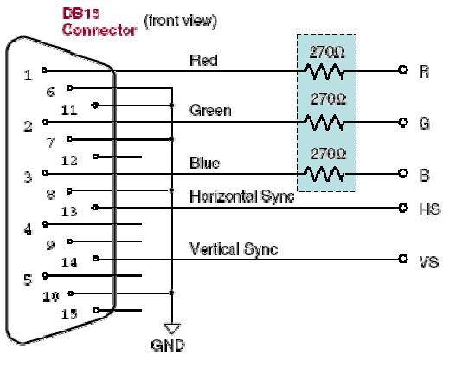
DB15 connector
DAC !
RGB Color
000 black
001 blue
010 green
011 cyan
100 red
101 magenta
110 yellow
111 white

Slide 5
VGA video signal generation
A VGA video signal contains 5 active signals:
• horizontal sync: digital signal, used for synchronisation of the video.
• vertical sync: digital signal, used for synchronisation of the video.
• red (R): analog signal (0-0.7 v).
• green (G): analog signal (0-0.7 v).
• blue (B): analog signal (0-0.7 v).
By changing the analog levels of the three RGB signals all other colors are produced
The electron beam must be scanned over the viewing screen in a sequence of horizontal lines to generate an image. The RGB color information in the video signal is used to control the strength of the electron beam.

Slide 6
VGA feature
In 640 by 480-pixel mode, with a 60 Hz refresh rate, this is approximately 40 ns per pixel. A 25 MHz clock has a period of 40 ns
During the time when pixel data is not being displayed and the beam is returning to the left column to start another horizontal scan, the RGB signals should all be set to black color (all zero)
In a PC graphics card, a dedicated memory location is used to store the color value of every pixel in the display. This memory is read out as the beam scanns across the screen to produce the RGB signals

Slide 7
horizontal sync
Front porch
TFP
Back porch
TBP
640
Pulse width
TPW
660
756
800

Slide 8
vertical sync
Front porch
TFP
Back porch
TBP
480
Pulse width
TPW
494
495
525

Slide 9
VGA sync generation
-- horiz_sync ------------------------------------__________--------
-- h_count 0 640 659 755 799
process (h_count_reg)
begin
h_count_next <=h_count_reg ;
if (h_count_reg = 799) then
h_count_next <= (others=>'0') ;
else
h_count_next <= h_count_reg + 1;
end if;
end process ;
--generate horizontal sync signal using h_count
horiz_sync <= '0' when (h_count_reg <= 755) and (h_count_reg >= 659) else
'1';
use a counter : 0 to 799
3 comparator

Slide 10
VGA sync generation
-- vert_sync -----------------------------------------------_______------------
-- v_count 0 480 493 494 524
process (v_count_reg,h_count_reg)
begin
v_count_next <= v_count_reg;
if (v_count_reg >= 524) and (h_count_reg >= 699) then
v_count_next <= (others=>'0') ;
elsif (h_count_reg = 699) then
v_count_next <= v_count_reg + 1;
end if;
end process;
-- generate vertical sync signal using v_count
vert_sync <= '0' when (v_count_reg <= 494) and (v_count_reg >= 493) else
'1';
use a counter : 0 to 524
5 comparator

Slide 11
VGA sync generation
-- generate video on screen signals for pixel data
video_on_h <= '1' when (h_count_reg <= 639) else
'0';
video_on_v <= '1' when (v_count_reg <= 479) else
'0';
-- video_on is high only when rgb data is displayed
video_on <= video_on_h and video_on_v;
cloked_process : process( clk_25mhz, rst )
begin
if( rst='1' ) then
h_count_reg <= (others=>'0') ;
v_count_reg <= (others=>'0') ;
elsif( clk_25mhz'event and clk_25mhz='1' ) then
h_count_reg <= h_count_next;
v_count_reg <= v_count_next;
end if;
end process ;

Slide 12
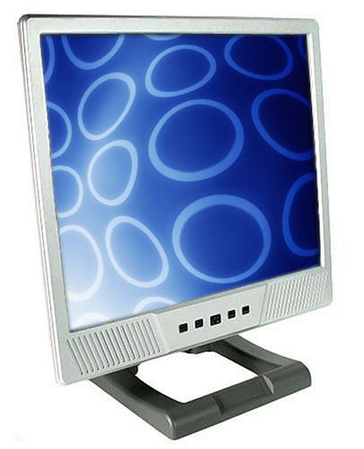
Elementary graphics card
sync generation
counters
25MHz clock
hsync
vsync
row
col
Vedio_on
BinData to display
or / and
OpenGL instruction
pixel RAM
or / and
pixel generator
R
G
B

Slide 13
exp1 : Line On Diagonal
red_out <= '1' when (pixel_row = pixel_column) and video_on = '1' else
'0';
green_out <= '1' when (pixel_row = pixel_column) and video_on = '1' else
'0' ;
blue_out <= '1' when (pixel_row = pixel_column) and video_on = '1' else
'0';

Slide 14
VGA sync generation
I/O Pin Assignments
NET "clk" LOC = "T9" ;
NET "blue" LOC = "R11" ;
NET "green" LOC = "T12" ;
NET "red" LOC = "R12" ;
NET "vs" LOC = "T10" ;
NET "hs" LOC = "R9" ;

Slide 15

exp2 : Cam To VGA
cam_Y
ram_dual
Dual Port
RAM
D1
Q1
Port A
Port B
pixel_data
CanAdressGen
we1
Pixel_adrs
vga_sync
adrs1
adrs2
clk1
clk2
clk_25mhz
green
blue
red
vert_sync
horiz_sync
Vsyn
Hsyc
clk_cam
cam_Y
Size :352x288
Pclk2 :4.4M
Size :640x480
Pclk1 :25M
OmniVision OV6620
CMOS image sensor.
VGA Screen

Slide 16
Dual Port RAM
coding style
entity ram_dual is
generic( d_width : integer ;
addr_width : integer ;
mem_depth : integer );
port ( o2 : out STD_LOGIC_VECTOR(d_width - 1 downto 0);
we1 : in STD_LOGIC;
clk1 : in STD_LOGIC;
d1 : in STD_LOGIC_VECTOR(d_width - 1 downto 0);
addr1 : in unsigned(addr_width - 1 downto 0);
clk2 : in STD_LOGIC;
addr2 : in unsigned(addr_width - 1 downto 0) );
end ram_dual;
ram_dual
Dual Port
RAM
D1
Q1
Port A
Port B
we1
adrs1
adrs2
clk1
clk2
architecture RAM_dual_arch of ram_dual is
type mem_type is array (mem_depth - 1 downto 0) of STD_LOGIC_VECTOR (d_width - 1 downto 0);
signal mem : mem_type;

Slide 17
Dual Port RAM coding style
FPGA :
- Already Supported by FPGA provider
- Synthesis recognize specific coding style
ASIC : (using specific generator)
- .db file for synthesis
- .hdl file for simulation
Resolve meta-stability problem between
VGA clock and Cam clock
begin
write_port : process ( clk1 )
begin
if (clk1'event and clk1 = '1') then
if ( we1 = '1') then
mem(conv_integer(addr1)) <= d1;
end if;
end if;
end process write_port ;
read_port : process ( clk2 )
begin
if (clk2'event and clk2 = '1') then
o2 <= mem(conv_integer(addr2)) ;
end if;
end process read_port ;
end RAM_dual_arch;
ram_dual
Dual Port
RAM
D1
Q1
Port A
Port B
we1
adrs1
adrs2
clk1
clk2

Slide 18
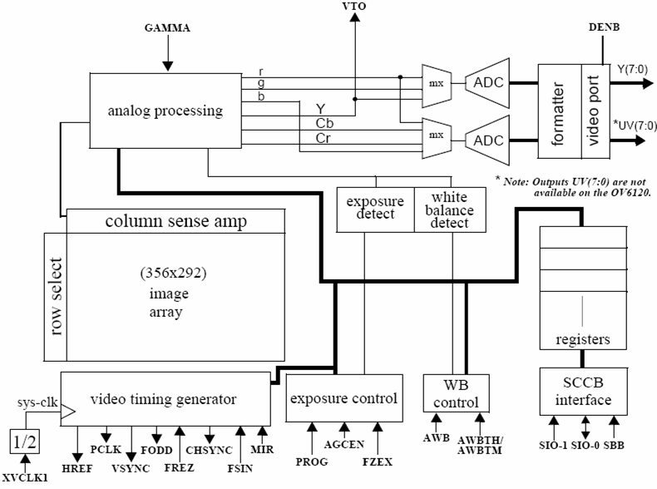
Cam : OmniVision OV6620
Features :
101,376 pixel, CIF/QCIF format
Array Size 356x 292 pixels
- 8/16 bit video data :
CCIR601, CCIR656, ZV port
- Data format
YCrCb 4:2:2, GRB 4:2:2, RGB
I2C interface for reconfiguration
We only focus & use :
- default configuration : 352x288
- Pclk : Pixel clock
- Href : Horizontal window reference
- Vsync : Vertical Sync
- Y[7:0] : 8 Bit luminance data bus

Slide 19
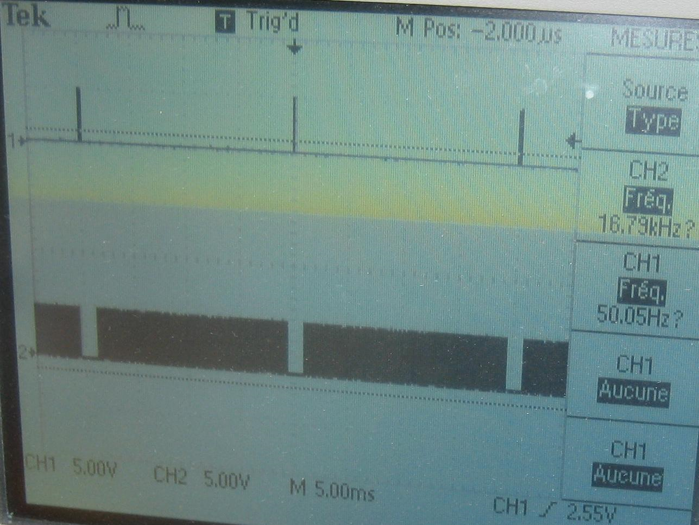
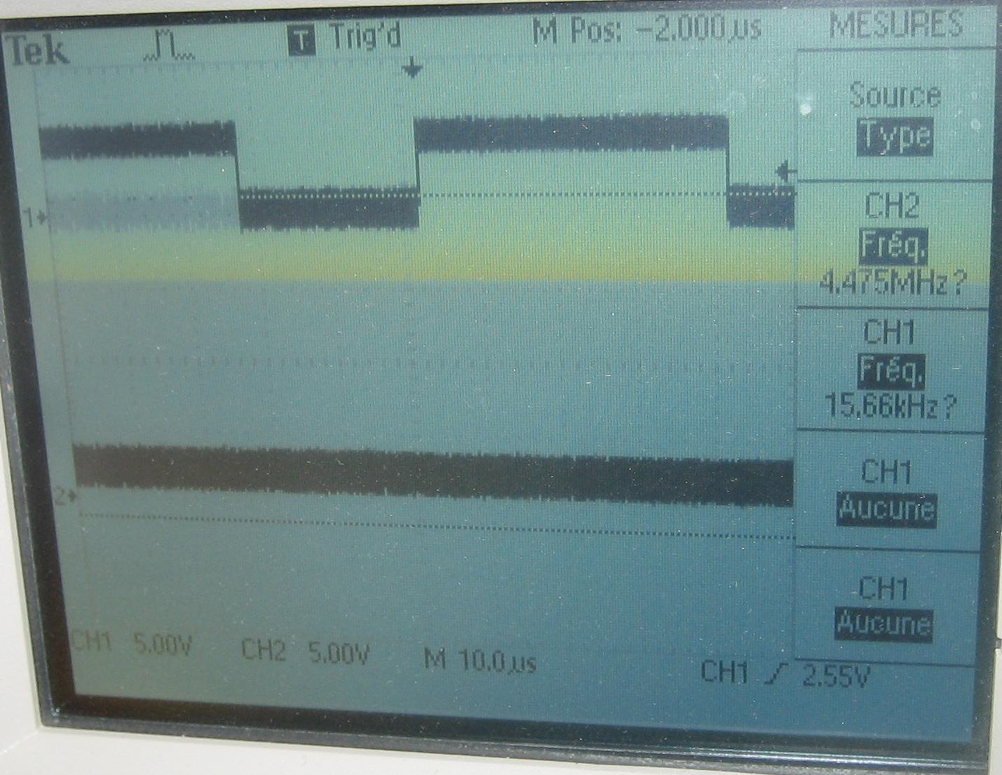
Vsync & Href & Pclk
Defaut configuration : Vsync : 50Hz Href ~16.8 Khz Pclk 4.475Mhz

Slide 20
CanAdressGen
COUNTER_GEN : process( hcount_reg, hinc_reg, hinc_next, vinc_reg)
begin
hcount_next <= hcount_reg;
if ( hinc_reg = '0' ) then
hcount_next <= (others=>'0');
else
hcount_next <= hcount_reg + 1 ;
end if ;
end process ;
COUNTER2_GEN : process(vcount_reg,vinc_reg,vinc_next,hinc_reg,hinc_next)
begin
vcount_next <= vcount_reg;
if ( vinc_reg = '1' ) then
vcount_next <= (others=>'0');
elsif( hinc_reg = '0' and hinc_next = '1') then
vcount_next <= vcount_reg + 1 ;
end if ;
end process ;

Slide 21
Controls Signal : Cam domain
64
To save 352x288 pixel we need 812k bits
Our FPGA : XC3S1500 has 576k bits
We only save 64x64 pixel in memory
We need 6bit,6bit to address the needed windows, all other address bits are zero
64
pixel
save
pixel don’t save
288
352
ram_we1 <= '1' when vcount_reg < 64 and hcount_reg < 64 else
'0';
ram_addr1<= vcount_reg (5 downto 0) & hcount_reg(5 downto 0);

Slide 22
Controls Signal : VGA domain
64
We only display 64x64 pixel
We need 6bit,6bit to address the needed windows, all other bits are zero
64
pixel
on
pixel
off
480
640
ram_addr2 <= pixel_row(5 downto 0) & pixel_column(5 downto 0);
valid <= '1' when pixel_row < 64 and pixel_column <64 else
'0';

Slide 23
I/O Pin Assignments
# cam signal
NET cam_pclk LOC=AA12;
NET cam_hsyn LOC = D2 ;
NET cam_vsyn LOC = E3 ;
#NET cam_rst LOC = E2 ;
NET cam_Y<0> LOC = V3;
NET cam_Y<1> LOC = U5;
NET cam_Y<2> LOC = T5;
NET cam_Y<3> LOC = V1;
NET cam_Y<5> LOC = T2;
NET cam_Y<4> LOC = U4;
NET cam_Y<6> LOC = N4;
NET cam_Y<7> LOC = U3;
# VGA clock & reset
NET clk_25mhz LOC = B11 ;
NET horiz_sync_out LOC = E11;
NET vert_sync_out LOC = D11;
NET blank_out LOC = A4 ;
NET csync_out LOC = A3 ;
NET green_out<0> LOC = F10;
NET green_out<1> LOC = D10;
NET green_out<2> LOC = A10;
NET green_out<3> LOC = D9;
NET green_out<4> LOC = A9;
NET green_out<5> LOC = B9;
NET green_out<6> LOC = A8;
NET green_out<7> LOC = B8;
NET red_out<0> LOC = D6;
NET red_out<1> LOC = C6;
NET red_out<2> LOC = B6;
NET red_out<3> LOC = D5;
NET red_out<4> LOC = A5;
NET red_out<5> LOC = B5;
NET red_out<6> LOC = C5;
NET red_out<7> LOC = B4;
NET blue_out<0> LOC = E9;
NET blue_out<1> LOC = F9;
NET blue_out<2> LOC = D7;
NET blue_out<3> LOC = C7;
NET blue_out<4> LOC = E7;
NET blue_out<5> LOC = F7;
NET blue_out<6> LOC = E6;
NET blue_out<7> LOC = F6;

Slide 24
Upgrading
Ability to I2C configuration
  active RGB rather than YUV
  active external clock Cam option using to synchronize the 2 clock domain (Cam, System)
Use external SRAM, SDRAM or DDRAM.
  Must be seen as Dual Port RAM : (transparent for user)
  Store the hole image : 352x288:24bits
  Use 2 image buffer option to allows image processing on image

Slide 25
exp3 : Keyboard (PS2) To VGA
kbdata
keyPS2controller
kb_data
ram_dual
Dual Port
RAM
Index_char
font_rom
kbclk
D1
Q1
Port A
Port B
pixel_data
ack
data_ready
back_space
counter
curent_char
vga_sync
cur_position
adrs1
adrs2
inc
dec
we1
green
blue
red
vert_sync
horiz_sync
ctr

